Slide 1


The Incidence of Farm Commodity Price Increases on U.S. Food Consumers
– A First Look
Julian M. Alston
University of California, Davis
Workshop on Food Prices and Forecasting
Sponsored by USDA ERS
New Orleans Marriott
July 31–August 1, 2024

Slide 2



Project team
Joint work with Abby Okrent, Wenjie Zhan, and Tim Beatty
Supported by USDA ERS and Giannini Foundation
Abigail Okrent
Senior Economist, Diet, Safety, and Health Economics Branch of the Food Economics Division USDA-ERS
Wenjie Zhan,
Graduate Student Researcher, Department of Agricultural and Resource Economics, UC Davis
Timothy Beatty
Professor and Department Chair, Department of Agricultural and Resource Economics, UC Davis

Slide 3
Project team
Joint work with Abby Okrent, Wenjie Zhan, and Tim Beatty
Supported by USDA ERS and Giannini Foundation
Abigail Okrent
Senior Economist, Diet, Safety, and Health Economics Branch of the Food Economics Division USDA-ERS
Wenjie Zhan,
Graduate Student Researcher, Department of Agricultural and resource Economics, UC Davis
Timothy Beatty
Professor and Department Chair, Department of Agricultural and resource Economics, UC Davis
This presentation was supported by the U.S. Department of Agriculture, Economic Research Service. The findings and conclusions in this presentation are those of the author(s) and should not be construed to represent any official USDA or U.S. Government determination or policy.

Slide 4
Objectives
Over the past four years, various factors contributed to 40-year highs in U.S. food prices
The objective of this cooperative project is to examine the impacts of the recent price spike on consumer welfare and diet outcomes.
The current analysis is focused on the role of increases in farm commodity prices as a contributor to these outcomes

Slide 5
In this work in progress we …
Extend the EDM developed by Okrent and Alston (2012) to allow for multiple cohorts of consumers, disaggregated according to their wealth status
Update the parameters using new data and revised estimation procedures
Examine the effects of exogenous changes in prices of M = 10 farm commodities on retail prices of N = 10 “food” products, and hence on per capita quantities demanded by each group of consumers
Translate those changes in per capita demanded of the various food products into measures of healthy eating (the Healthy Eating Index), obesity (BMI and its social cost), and consumer welfare (compensating variation)

Slide 10
Acceleration since 2019: food prices
Period | Implicit GDP price deflator | Cereals & bakery | Meats | Eggs | Dairy | Fruits & vegetables | Other FAH | FAFH | Nonalcoholic beverages | Alcoholic beverages | Nondurables (excl. food) |  | Average
 | average increase, percent per year – nominal prices
2000-19 | 1.92 | 2.06 | 2.73 | 3.04 | 1.65 | 2.01 | 1.62 | 2.76 | 1.22 | 2.01 | 1.93 |  | 2.10
2020-23 | 4.15 | 6.48 | 6.16 | 10.59 | 5.44 | 3.90 | 6.40 | 5.66 | 6.09 | 3.11 | 4.43 |  | 5.83
Difference | 2.23 | 4.43 | 3.43 | 7.55 | 3.79 | 1.90 | 4.78 | 2.90 | 4.87 | 1.10 | 2.50 |  | 3.72

Slide 11
Acceleration since 2019: food prices
Period | Implicit GDP price deflator | Cereals & bakery | Meats | Eggs | Dairy | Fruits & vegetables | Other FAH | FAFH | Nonalcoholic beverages | Alcoholic beverages | Nondurables (excl. food) |  | Average
 | average increase, percent per year – nominal prices
2000-19 | 1.92 | 2.06 | 2.73 | 3.04 | 1.65 | 2.01 | 1.62 | 2.76 | 1.22 | 2.01 | 1.93 |  | 2.10
2020-23 | 4.15 | 6.48 | 6.16 | 10.59 | 5.44 | 3.90 | 6.40 | 5.66 | 6.09 | 3.11 | 4.43 |  | 5.83
Difference | 2.23 | 4.43 | 3.43 | 7.55 | 3.79 | 1.90 | 4.78 | 2.90 | 4.87 | 1.10 | 2.50 |  | 3.72
 | average increase, percent per year – deflated prices
2000-19 |  | 0.13 | 0.79 | 1.08 | -0.28 | 0.08 | -0.29 | 0.82 | -0.69 | 0.09 | -0.01 |  | 0.17
2020-23 |  | 2.22 | 1.94 | 6.04 | 1.23 | -0.24 | 2.14 | 1.46 | 1.86 | -0.97 | 0.16 |  | 1.58
Difference |  | 2.08 | 1.15 | 4.96 | 1.51 | -0.32 | 2.44 | 0.64 | 2.54 | -1.06 | 0.17 |  | 1.41

Slide 12
Acceleration since 2019: farm prices
Period | Implicit GDP price deflator | Fruits & tree nuts | Food grains | Poultry & eggs | Dairy products | Hogs | Beef cattle | Vegetables & melons | Oil-bearing crops | Fish & seafood | Sugar & peanuts |  | Average
 | average increase, percent per year – nominal prices
2000-19 | 1.92 | 3.16 | 4.88 | 2.18 | -1.38 | 4.24 | 3.54 | 3.02 | 4.36 | 2.43 | 1.06 |  | 2.75
2020-23 | 4.15 | 6.58 | 11.49 | 18.30 | 1.54 | 6.90 | 11.34 | 8.46 | 12.54 | 13.10 | 13.26 |  | 10.35
Difference | 2.23 | 3.42 | 6.61 | 16.12 | 2.92 | 2.66 | 7.80 | 5.44 | 8.18 | 10.67 | 12.20 |  | 7.60

Slide 13
Acceleration since 2019: farm prices
Period | Implicit GDP price deflator | Fruits & tree nuts | Food grains | Poultry & eggs | Dairy products | Hogs | Beef cattle | Vegetables & melons | Oil-bearing crops | Fish & seafood | Sugar & peanuts |  | Average
 | average increase, percent per year – nominal prices
2000-19 | 1.92 | 3.16 | 4.88 | 2.18 | -1.38 | 4.24 | 3.54 | 3.02 | 4.36 | 2.43 | 1.06 |  | 2.75
2020-23 | 4.15 | 6.58 | 11.49 | 18.30 | 1.54 | 6.90 | 11.34 | 8.46 | 12.54 | 13.10 | 13.26 |  | 10.35
Difference | 2.23 | 3.42 | 6.61 | 16.12 | 2.92 | 2.66 | 7.80 | 5.44 | 8.18 | 10.67 | 12.20 |  | 7.60
 |  | average increase, percent per year – deflated prices
2000-19 |  | 1.20 | 2.84 | 0.23 | -3.24 | 2.25 | 1.57 | 1.08 | 2.37 | 0.49 | -0.84 |  | 0.79
2020-23 |  | 2.37 | 7.05 | 13.05 | -2.42 | 2.52 | 6.81 | 3.91 | 8.35 | 8.66 | 8.78 |  | 5.91
Difference |  | 1.18 | 4.21 | 12.82 | 0.82 | 0.27 | 5.23 | 2.83 | 5.97 | 8.17 | 9.62 |  | 5.11

Slide 14

A Model of the Linkage Between Markets for Farm Commodities and Retail Food Products
Okrent (2010), Okrent and Alston (2012)
Okrent, A.M. and J.M. Alston. “The effects of farm commodity and retail food policies on obesity and economic welfare in the United States.” AJAE 94(3)(2012): 611–646.

Slide 15
U.S. food sector model
Weight Outcomes
Food Consumption
Food At Home
Food Away From Home
Alcoholic Beverages
Food Manufacturers, Distributors, Retailers, Wholesalers
Fruits & Vegetables
Other Crops
Meat Animals
Okrent, A.M. and J.M. Alston. “The effects of farm commodity and retail food policies on obesity and economic welfare in the United States.” AJAE 94(3)(2012): 611–646.

Slide 16
Linkages between farm and retail
Cereals and bakery
Non-alcoholic drinks
Meats and eggs
Dairy
F&V
Other food
FAFH
Alcohol
Nonfood
Marketing inputs
Other food crops
Grains
Meat animals
Milk
F&V
Oilseeds
Sugar

Slide 17
Linkages between farm and retail
Cereals and bakery
Non-alcoholic drinks
Meats and eggs
Dairy
F&V
Other food
FAFH
Alcohol
Nonfood
Marketing inputs
Other food crops
Grains
Meat animals
Milk
F&V
Oilseeds
Sugar

Slide 18
Conceptual structure
Modified Trade Expenditure Function Model
Commodity Supply Equations
Commodity Demand Equations
Food Demand Equations
Changes in welfare as a function of elasticities, exogenous changes in tax rates, and endogenous changes in prices
Equilibrium Displacement Model
Changes in prices as a function of elasticities and changes in tax rates
Multimarket Welfare Measures

Slide 19
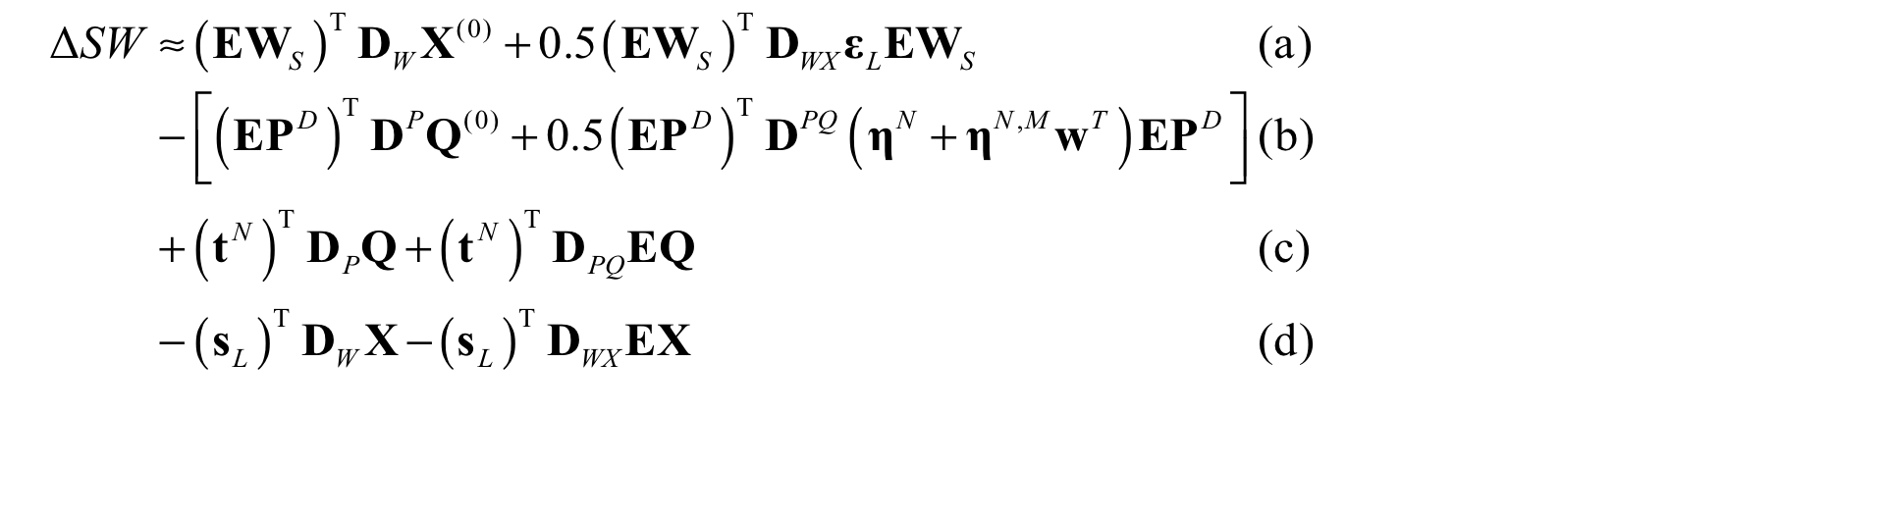
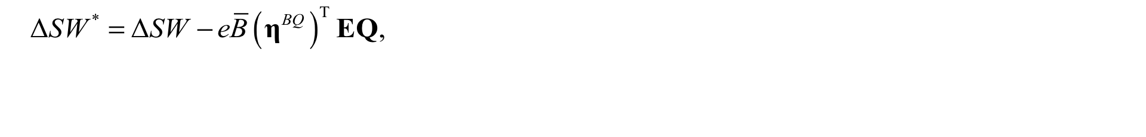

Welfare measure

Slide 20
Simulation procedure
Simulate exogenous farm commodity price changes
Based on caloric content of foods, derive measures of changes in total caloric consumption
Measures of changes in consumption of various food categories per U.S. adult per year
Using model of adult weight, derive measures of changes in steady-state weight and BMI
Derive measures of changes in consumer welfare and health-care externality costs

Slide 21
“New” elasticities of demand
Estimated using EASI demand system (Lewbel and Pendakur)
U.S. Consumer Expenditure Diary Survey, 2010–2019:
urban household heads 18–65 years of age
62,018 households (after we drop top and bottom 1% total expenditure)
Stone-Lewbel food price indexes constructed from monthly CPIs
nonfood price constructed as by Zhen et al. (2024)
nominal expenditure median-normalized

Slide 22
“New” elasticities of demand
 | Lower Income Households (<$9,999) |  |  |  | Higher Income Households ( ≥ $10,000) |  |  |  | All Households
 | Budget share | Marshallian own-price elasticity | Expenditure elasticity |  | Budget share | Marshallian own-price elasticity | Expenditure elasticity |  | Budget share | Marshallian own-price elasticity | Expenditure elasticity
Cereals & bakery | 0.021 | -0.93 | 0.83 |  | 0.005 | -0.70 | 0.31 |  | 0.009 | -0.49 | 0.65
Meats | 0.038 | -0.89 | 0.82 |  | 0.009 | -0.55 | 0.39 |  | 0.015 | -0.68 | 0.67
Eggs | 0.006 | -0.91 | 0.92 |  | 0.001 | -0.60 | 0.61 |  | 0.002 | -0.84 | 0.84
Dairy | 0.017 | -0.98 | 0.86 |  | 0.004 | -0.94 | 0.37 |  | 0.007 | -0.89 | 0.69
Fruits & vegetables | 0.029 | -0.97 | 0.85 |  | 0.007 | -0.90 | 0.30 |  | 0.012 | -0.91 | 0.67
Other foods | 0.036 | -1.04 | 0.85 |  | 0.009 | -1.16 | 0.33 |  | 0.015 | -0.96 | 0.67
FAFH | 0.082 | -0.94 | 0.88 |  | 0.025 | -0.83 | 0.57 |  | 0.036 | -1.05 | 0.74
Nonalcoholic beverages | 0.018 | -1.21 | 0.87 |  | 0.005 | -1.82 | 0.41 |  | 0.008 | -1.39 | 0.71
Alcoholic beverages | 0.041 | -1.27 | 0.99 |  | 0.011 | -2.28 | 0.93 |  | 0.015 | -1.69 | 0.96
Nonfood | 0.711 | -1.05 | 1.06 |  | 0.923 | -1.05 | 1.05 |  | 0.881 | -1.04 | 1.05

Slide 23
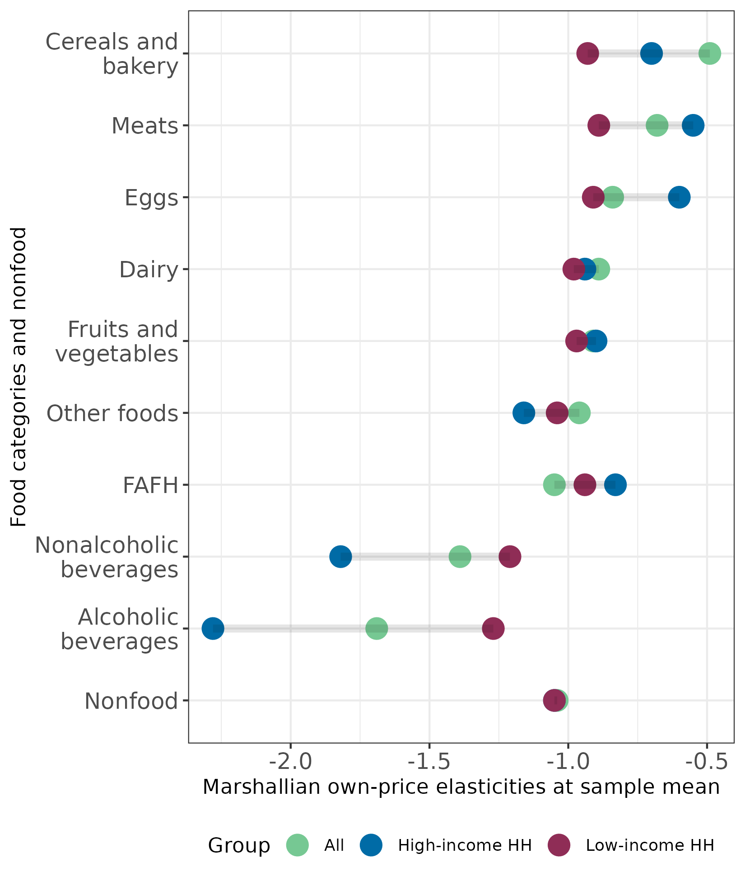
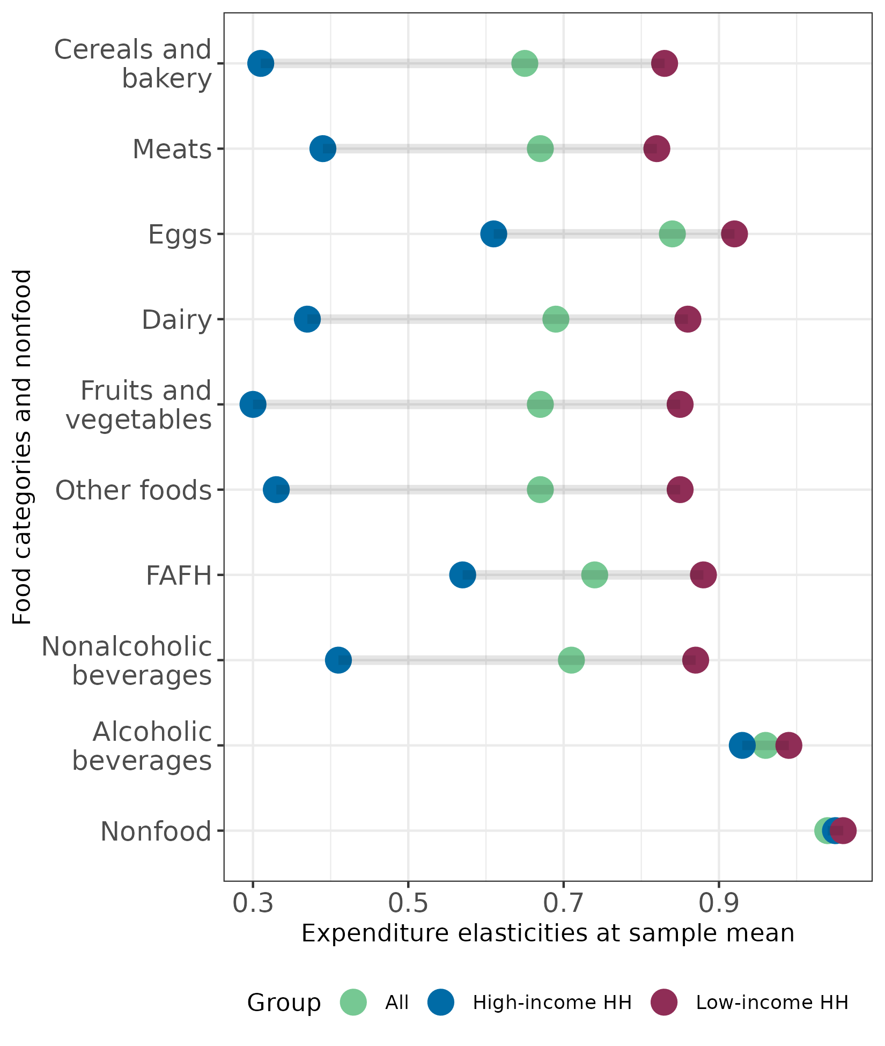
Own-price and expenditure elasticities of demand for subsamples
Marshallian own-price elasticities
Expenditure elasticities

Slide 24
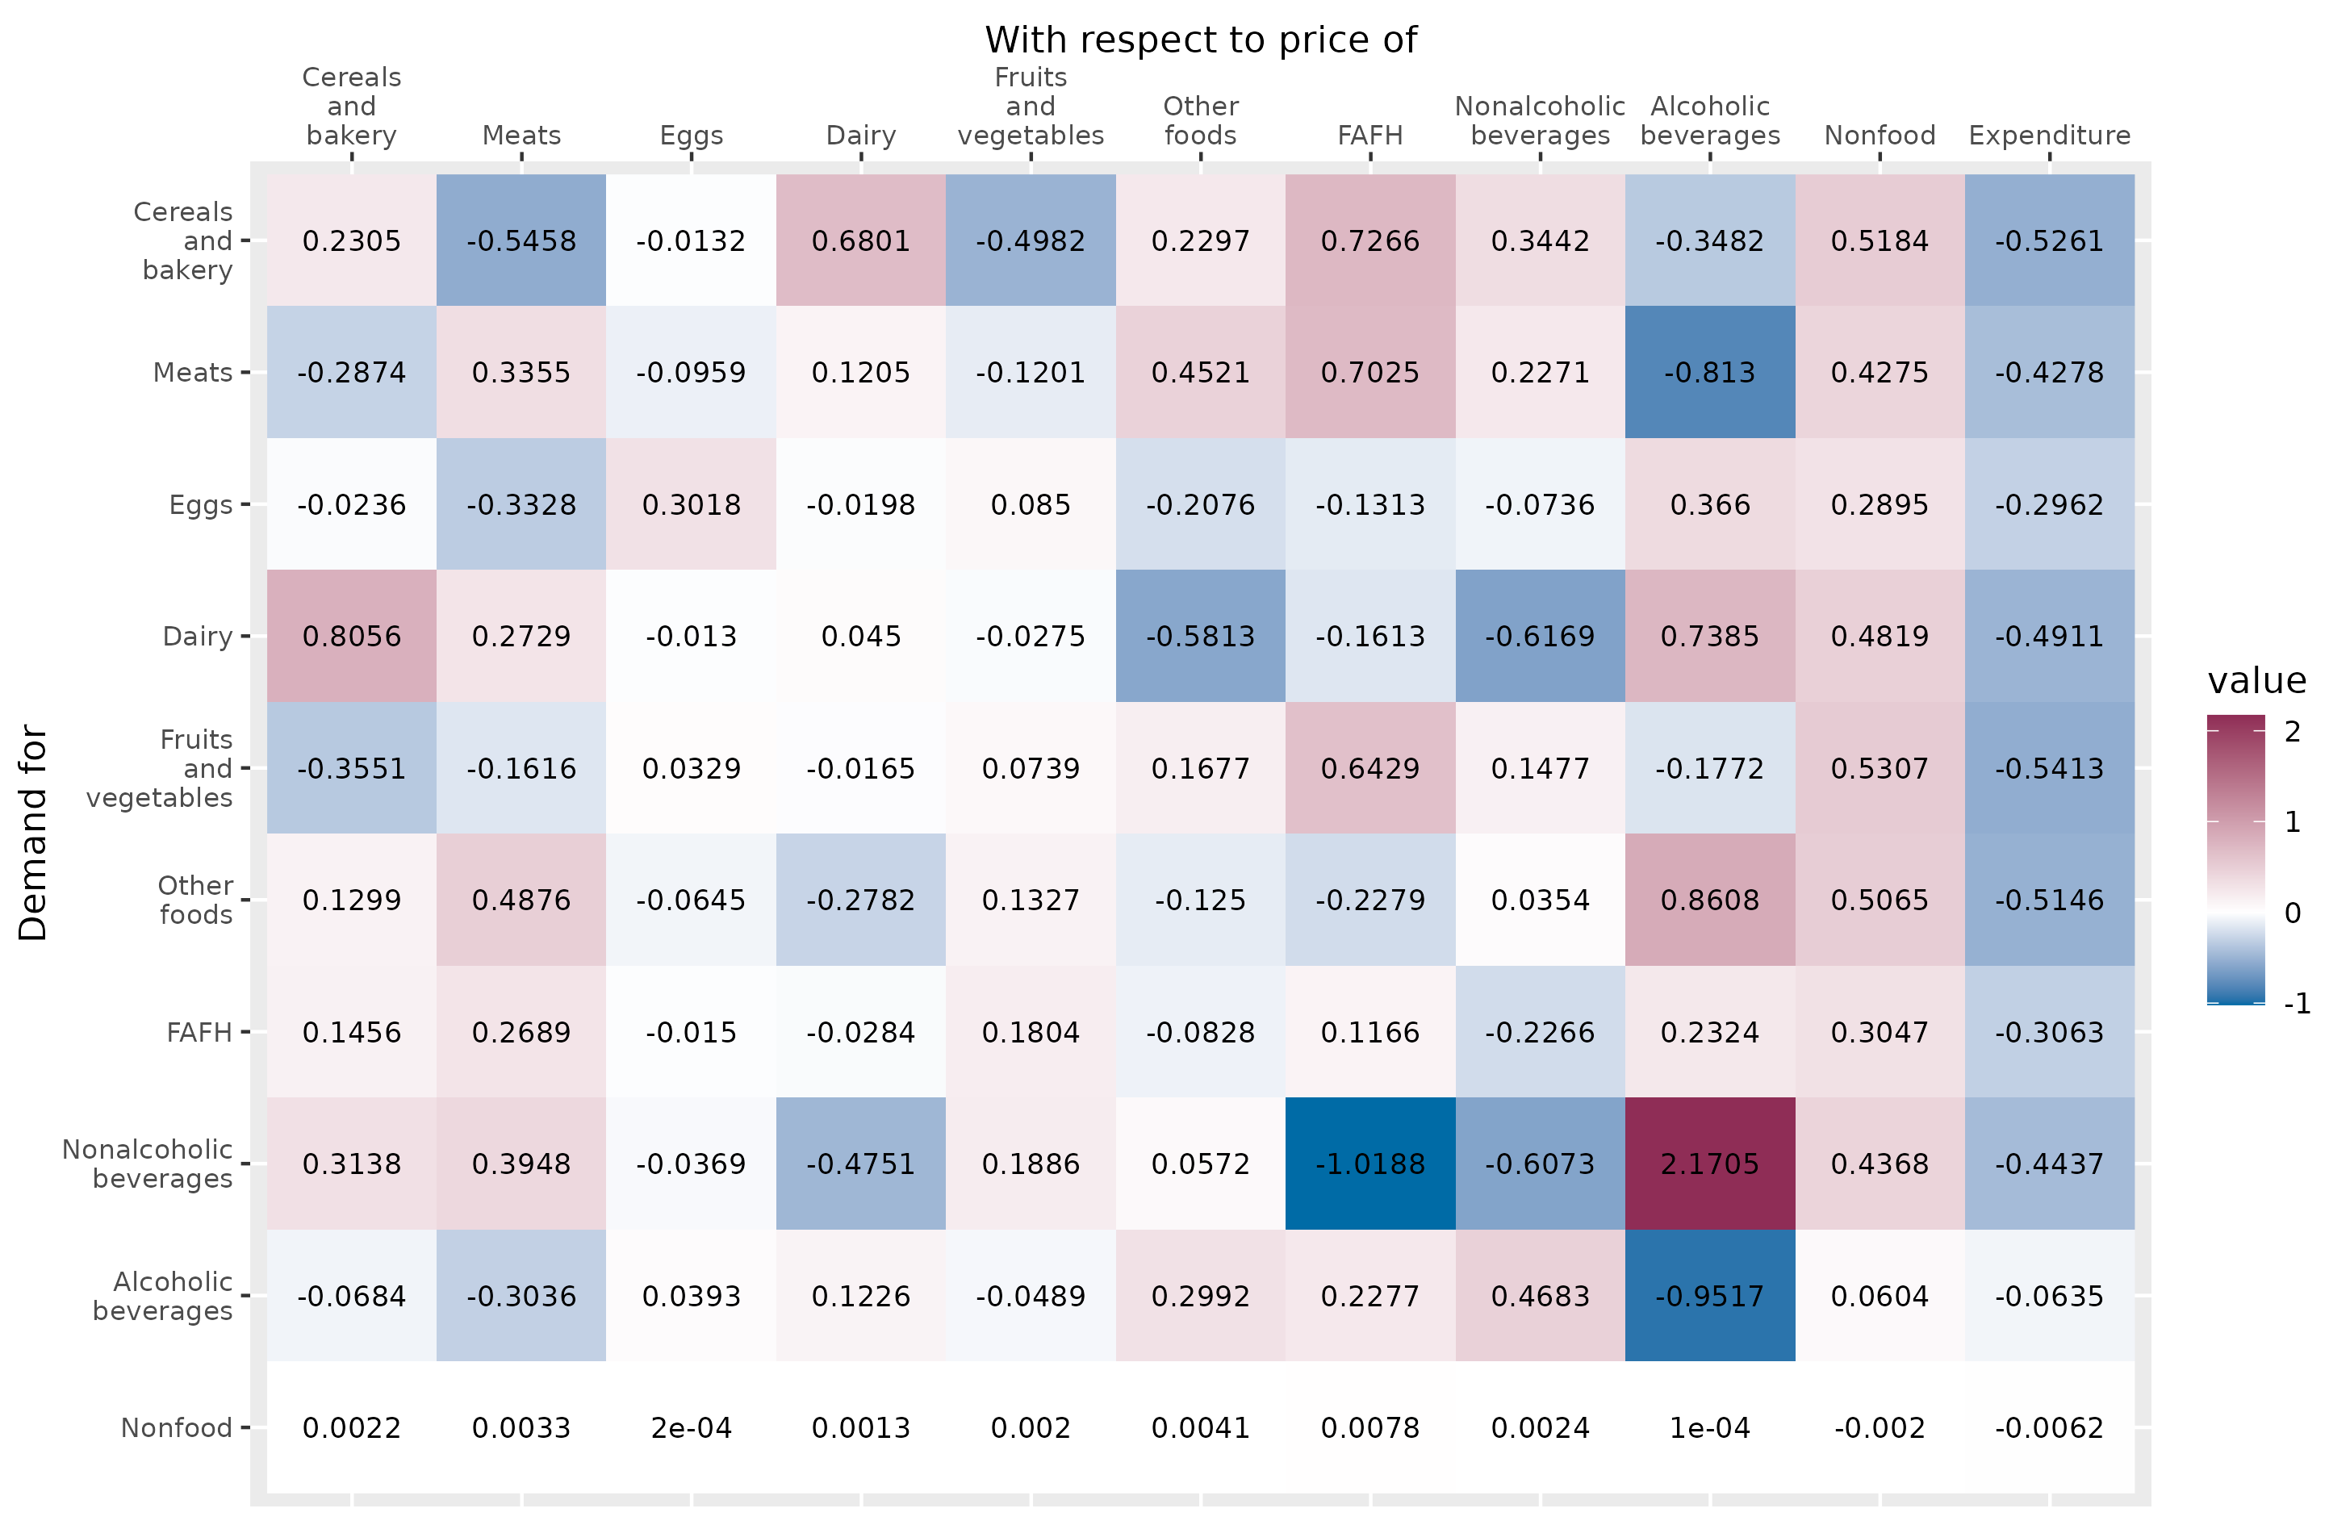
Elasticities of demand at sample means, difference (high inc. – low inc.)

Slide 25
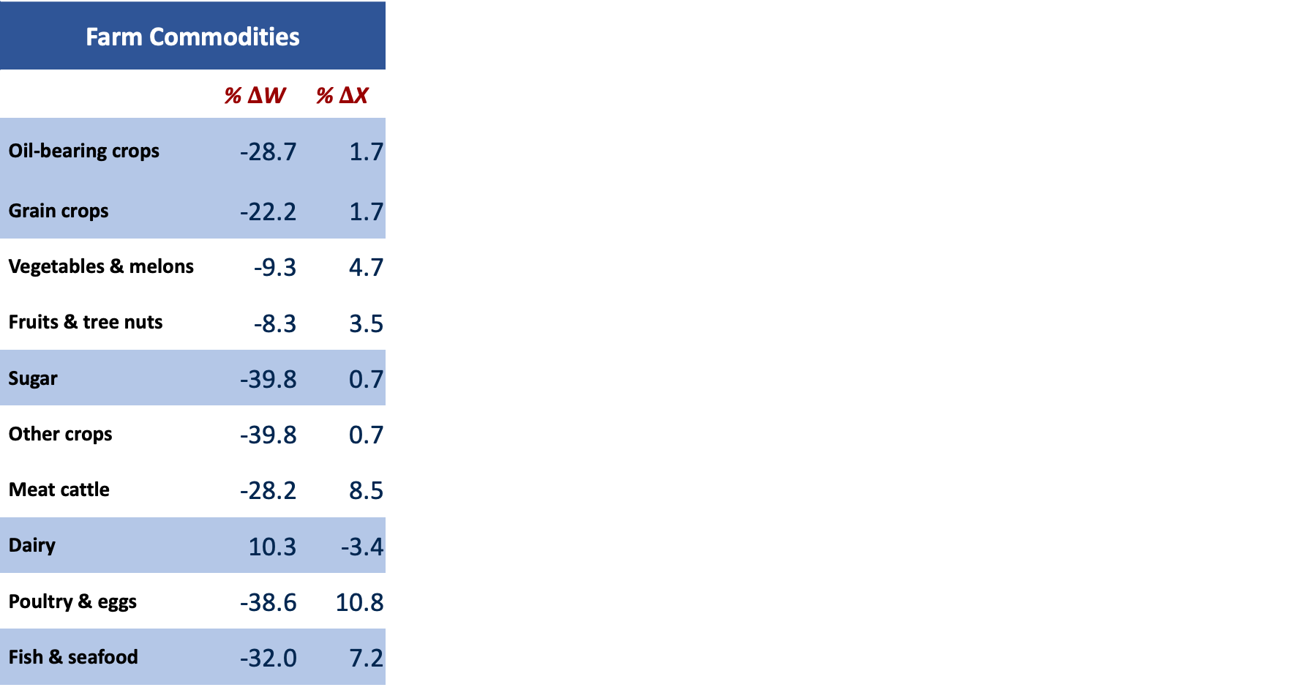
Reversion to 2019 farm commodity prices – new elasticities
Farm Commodities
 | % $Δ$W | % $Δ$X
Oil-bearing crops | -28.7 | 1.7
Grain crops | -22.2 | 1.7
Vegetables & melons | -9.3 | 4.7
Fruits & tree nuts | -8.3 | 3.5
Sugar | -39.8 | 0.7
Other crops | -39.8 | 0.7
Meat cattle | -28.2 | 8.5
Dairy | 10.3 | -3.4
Poultry & eggs | -38.6 | 10.8
Fish & seafood | -32.0 | 7.2

Slide 26
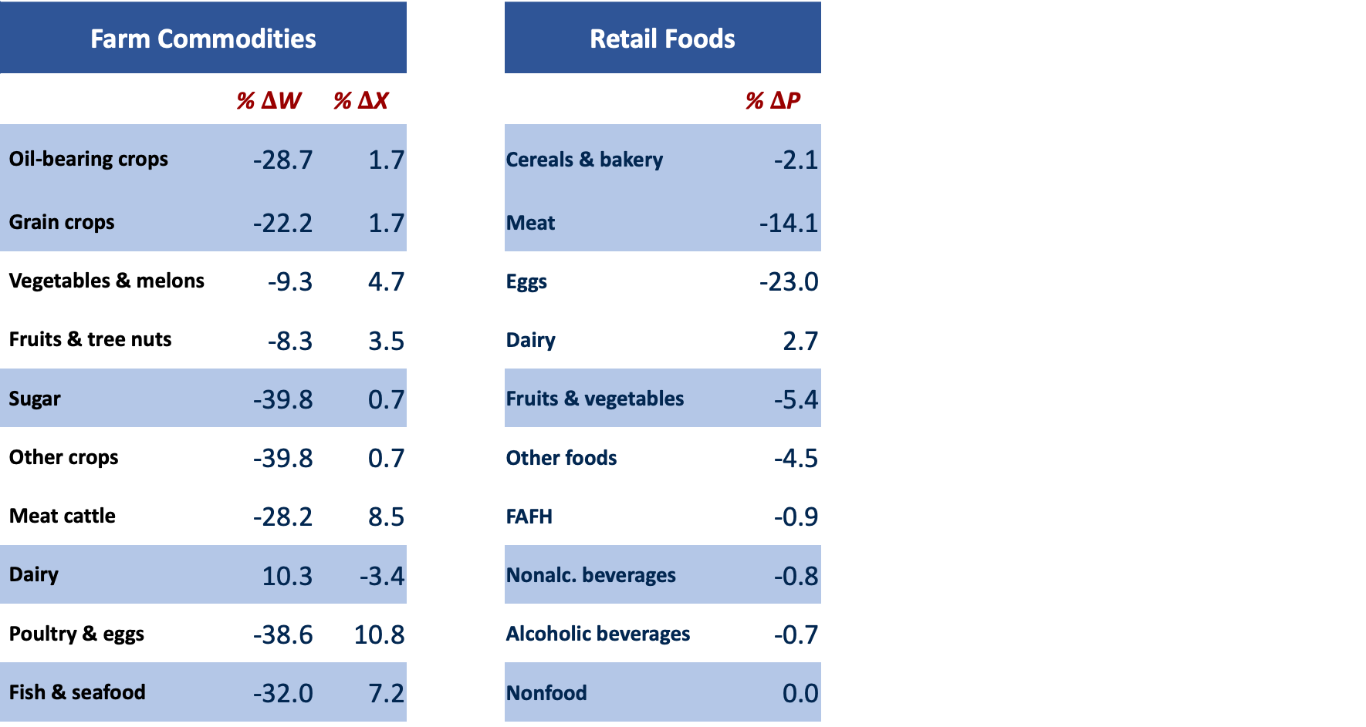
Reversion to 2019 farm commodity prices – new elasticities
Farm Commodities |  |  |  | Retail Foods |  |  | \
 | % $Δ$W | % $Δ$X |  |  | % $Δ$P
Oil-bearing crops | -28.7 | 1.7 |  | Cereals & bakery | -2.1
Grain crops | -22.2 | 1.7 |  | Meat | -14.1
Vegetables & melons | -9.3 | 4.7 |  | Eggs | -23.0
Fruits & tree nuts | -8.3 | 3.5 |  | Dairy | 2.7
Sugar | -39.8 | 0.7 |  | Fruits & vegetables | -5.4
Other crops | -39.8 | 0.7 |  | Other foods | -4.5
Meat cattle | -28.2 | 8.5 |  | FAFH | -0.9
Dairy | 10.3 | -3.4 |  | Nonalc. beverages | -0.8
Poultry & eggs | -38.6 | 10.8 |  | Alcoholic beverages | -0.7
Fish & seafood | -32.0 | 7.2 |  | Nonfood | 0.0

Slide 27
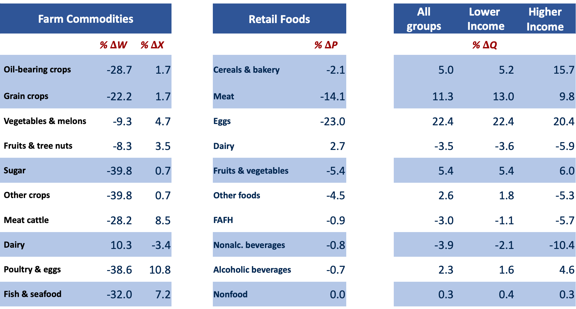
Reversion to 2019 farm commodity prices – new elasticities
Farm Commodities |  |  |  | Retail Foods |  |  | All groups | Lower Income | Higher Income
 | % $Δ$W | % $Δ$X |  |  | % $Δ$P |  | % $Δ$Q
Oil-bearing crops | -28.7 | 1.7 |  | Cereals & bakery | -2.1 |  | 5.0 | 5.2 | 15.7
Grain crops | -22.2 | 1.7 |  | Meat | -14.1 |  | 11.3 | 13.0 | 9.8
Vegetables & melons | -9.3 | 4.7 |  | Eggs | -23.0 |  | 22.4 | 22.4 | 20.4
Fruits & tree nuts | -8.3 | 3.5 |  | Dairy | 2.7 |  | -3.5 | -3.6 | -5.9
Sugar | -39.8 | 0.7 |  | Fruits & vegetables | -5.4 |  | 5.4 | 5.4 | 6.0
Other crops | -39.8 | 0.7 |  | Other foods | -4.5 |  | 2.6 | 1.8 | -5.3
Meat cattle | -28.2 | 8.5 |  | FAFH | -0.9 |  | -3.0 | -1.1 | -5.7
Dairy | 10.3 | -3.4 |  | Nonalc. beverages | -0.8 |  | -3.9 | -2.1 | -10.4
Poultry & eggs | -38.6 | 10.8 |  | Alcoholic beverages | -0.7 |  | 2.3 | 1.6 | 4.6
Fish & seafood | -32.0 | 7.2 |  | Nonfood | 0.0 |  | 0.3 | 0.4 | 0.3

Slide 28
Reversion to 2019 farm commodity prices – welfare effects
 |  | Simulations Using “New” Elasticities
 |  | All groups
∆ adult weight, one year | lbs/adult | 2.37
∆ adult weight, steady state | lbs/adult | 3.97
∆CS per adult | $/year | 268.3
(a) ∆CS total | $b/year | 66.3
(b) ∆ Public Health Care Cost | $b/year | 4.3
∆SW = (a) – (b) | $b/year | 62.0

Slide 29
Reversion to 2019 farm commodity prices – welfare effects
 |  | Simulations Using “New” Elasticities
 |  | All groups | Lower income | Higher income
∆ adult weight, one year | lbs/adult | 2.37 | 3.40 | -1.24
∆ adult weight, steady state | lbs/adult | 3.97 | 5.68 | -2.07
∆CS per adult | $/year | 268.3 | 158.9 | 307.3
(a) ∆CS total | $b/year | 66.3 | 10.9 | 54.8
(b) ∆ Public Health Care Cost | $b/year | 4.3 | 1.7 | -1.6
∆SW = (a) – (b) | $b/year | 62.0 | 9.2 | 56.4

Slide 30
Reversion to 2019 farm commodity prices – welfare effects
 |  | Simulations Using “New” Elasticities |  |  |  | Simulations Using “Old” Elasticities
 |  | All groups | Lower income | Higher income |  | All groups | Lower income | Higher income
∆ adult weight, one year | lbs/adult | 2.37 | 3.40 | -1.24 |  | 1.14 | 1.31 | 1.03
∆ adult weight, steady state | lbs/adult | 3.97 | 5.68 | -2.07 |  | 1.90 | 2.18 | 1.72
∆CS per adult | $/year | 268.3 | 158.9 | 307.3 |  | 263.5 | 154.6 | 305.4
(a) ∆CS total | $b/year | 66.3 | 10.9 | 54.8 |  | 65.1 | 10.6 | 54.5
(b) ∆ Public Health Care Cost | $b/year | 4.3 | 1.7 | -1.6 |  | 2.0 | 0.7 | 1.3
∆SW = (a) – (b) | $b/year | 62.0 | 9.2 | 56.4 |  | 63.0 | 9.9 | 53.2

Slide 31
“New” vs “Old” elasticities
“Old” elasticities (from Okrent and Alston 2012) based on analysis of time-series data on per capita disappearance
“New” elasticities (from current study) based on cross-sectional analysis of scanner data from individual households
– larger magnitudes of own-price and especially cross-price elasticities
– own-price elasticities closer to –1.0 (more elastic) than we might expect
– expenditure elasticities closer to 1.0 (more elastic) than we might expect
– comparable to those from Zhen et al. (2024)?
Zhen, Chen, Yu Chen, Biing-Hwan Lin, Shawn Karns, Lisa Mancino, and Michele Ver Ploeg. “Do obese and nonobese consumers respond differently to price changes? Implications of preference heterogeneity for obesity-oriented food taxes and subsidies.” AJAE 106(2024): 1058–1088

Slide 32
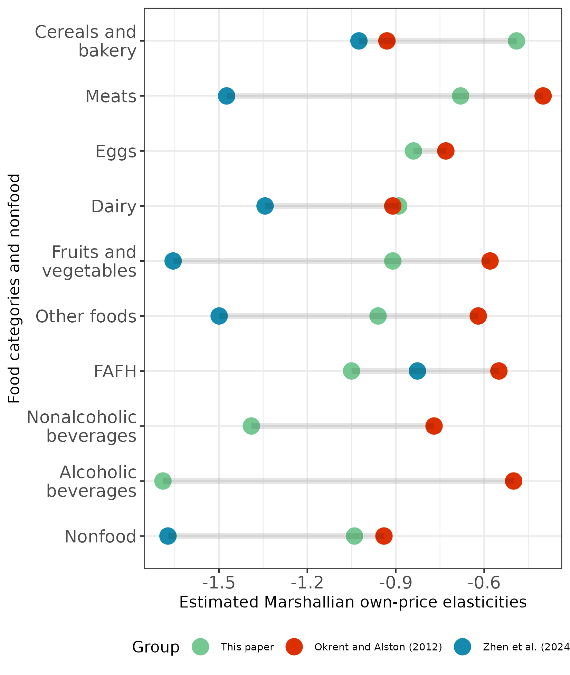
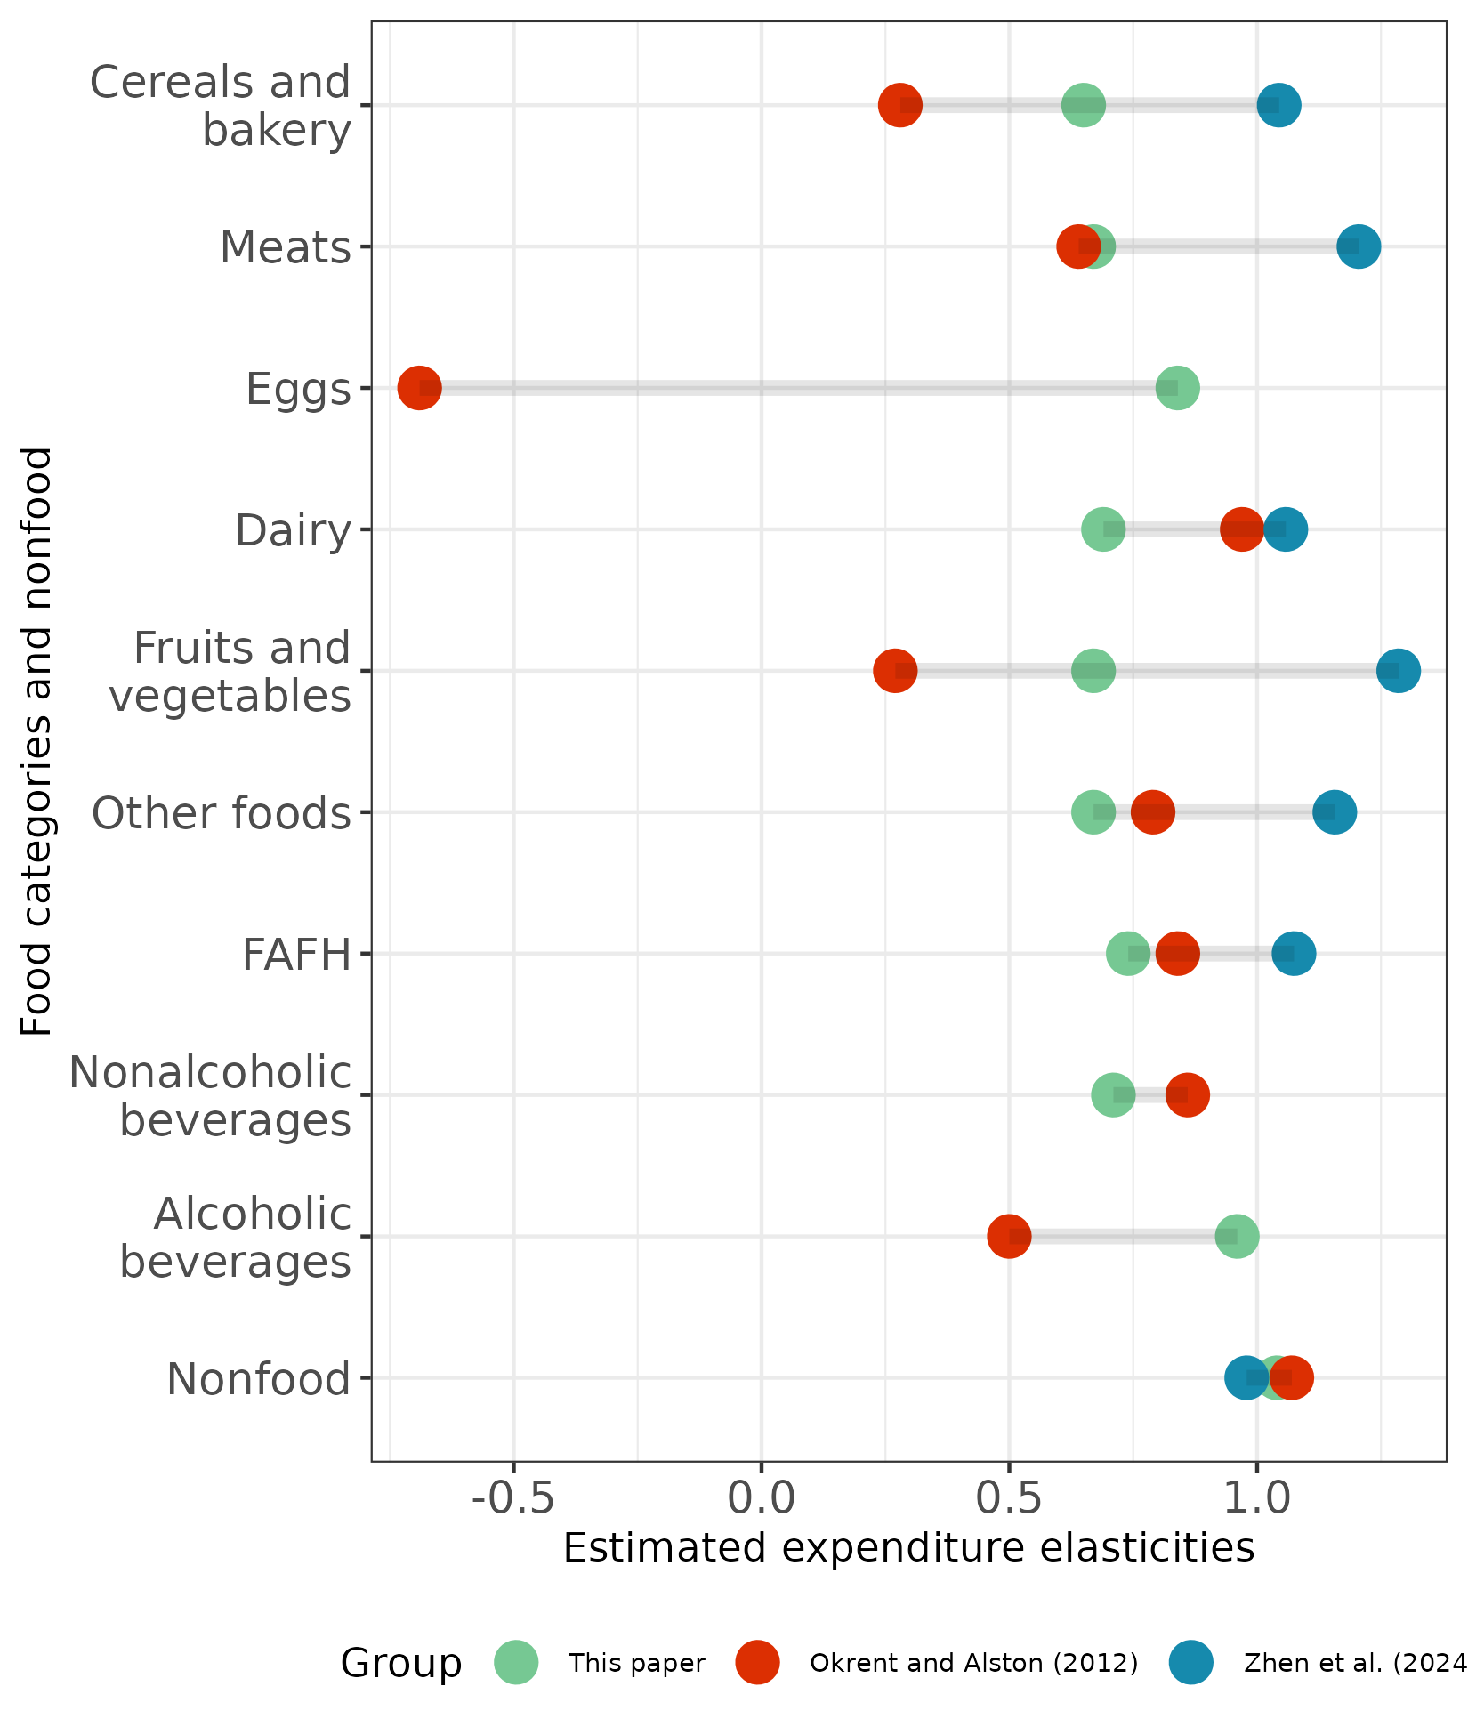
“New” vs “Old” elasticities
Marshallian own-price elasticities
Expenditure elasticities

Slide 33
“New” vs “Old” elasticities
Matter for measures of changes in consumption and health outcomes
Not so much for measures of welfare impact – dominated by “rectangles” associated with price changes and baseline consumption

Slide 34
What next?
More work on model validation and understanding elasticities of demand
Healthy Eating Index and other outcome measures
Other income classes
Other backward-looking and forward-looking experiments
Partition food price growth into parts attributable to increases in farm commodity prices and other factors
Assess the role of agricultural R&D and consequential farm productivity growth in offsetting the effects of other sources of food price inflation

Slide 35
Thank you!
jmalston@ucdavis.edu

